Slide 1

Improving Apache Commons CSV
Project Context
Project Goals
Methodological Steps
Results & Findings
Conclusions
Author: Luciano Bercini (0522501684)
Professor: Dario Di Nucci
Institute: University of Salerno

Slide 2
Project Context
Project Basis: Apache Commons CSV, a Java library for CSV file handling.
The project served as a foundation for applying software dependability techniques to a real-world, open-source project.
The library was chosen for its mature and relevant codebase.

Slide 3
Project Goals
The main objective was to enhance the dependability of the codebase without compromising functionality.
Specifically:
Improve code quality and clarity.
Strengthen the test suite for both coverage and fault detection.
Evaluate security risks.
Integrate real-world tools and practices:
CI/CD
Static analysis (SonarCloud)
Code coverage (JaCoCo)
Mutation testing (PiTest)
Automated test generation (Randoop)
Performance benchmarking (JMH)
Security analysis (FindSecBugs, OWASP-DC)
Containerization tool (Docker)

Slide 4


Clean Build & CI Setup
Initial setup:
Forked and cloned the official repository.
Performed a clean build using Maven to confirm a stable and working baseline.
Verified that all existing tests passed successfully.
CI Configuration:
Setup GitHub actions with a ci.yml workflow to compile and run the test suite automatically on push.
This ensures early error detection and maintains development consistency.

Slide 5

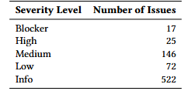
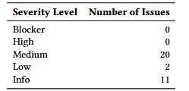
Static Analysis with SonarCloud
To enhance software quality, SonarCloud was integrated into the development process to perform static code analysis. This resulted in 778 issues and 4 bugs, by severity:
These issues included brain methods, eager testing, and many more.
After the refactoring, only few issues remained. In those issues there was commented out psql code to create resources, or TODO comments that required expanding the project.

Slide 6
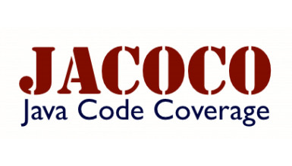

Code Coverage with JaCoCo
JaCoCo was used to measure how much of the code is exercised by tests.
Most of the classes had 100% coverage, with a few classes slightly falling behind.
The tool was used to pinpoint potential improvements of the test suite.

Slide 7

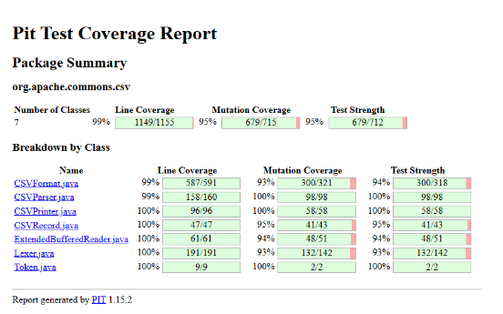
Mutation Test with PiTest
To evaluate test suite strength, PIT was used run mutation testing.
Key results:
95% mutation coverage
95% test strength
This confirmed that the tests are not only broad but also semantically effective in catching logic faults.

Slide 8

Unit Test Generation - Randoop
To complement the manual and mutation-based testing strategies, the Randoop tool was used to automatically generate test cases.
Randoop generated and saved 1300 regression tests.
Before using Randoop, the project already exhibited excellent coverage.
Nonethless, it slightly improved coverage and mutation coverage, particularly for the CSVFormat class:
Instruction Coverage: 98% to 99%.
Branch Coverage: 93% to 95%.
Mutation Coverage: 93% to 94%.

Slide 9
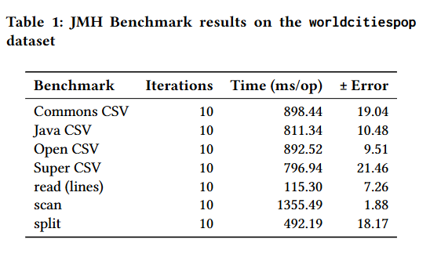
Benchmarking with JMH
Using JMH, parsing performance across libraries was measured.
All parsers processed the same GZIP-compressed CSV file (worldcitiespop.txt.gz).
As expected, low-level approaches such as line-by-line reading and splitting without full CSV compliance performed faster but lack feature support like multi-line fields.

Slide 10




Security Evaluation
Two tools were used:
OWASP Dependency-Check: flagged 2 medium-severity vulnerabilities in external libraries.
FindSecBugs: no vulnerabilities in project code.

Slide 11


Web Application Integration, dockerization and Continuous Delivery
To fulfill the deployment and orchestration requirements, a web-based application was added, and a custom Dockerfile was written to build a lightweight Docker image containing the compiled JAR.
To automate the build and delivery of the Docker image, a GitHub Actions workflow was created which:
Sets up a Java environment.
Builds the Maven Project into a JAR.
Logs in to DockerHub using secrets configured in the GitHub repository.
Builds the docker image and pushes it to DockerHub.

Slide 12
Results Summary
SonarCloud: Issues reduced from 782 to 33.
JaCoCo: 98% instruction coverage, 96% branch coverage.
PIT: 95% mutation coverage and test strength.
Randoop: added 1300 tests slightly improving coverage.
JMH: insights on performance for various libraries.
Security: project code marked as clean, only external risks were flagged.
Web Integration: a simple demonstration web-app (using Javalin) was integrated to the project.
Docker: A Docker Image ready to be orchestrated is available on DockerHub. The container is runnable.

Slide 13
Conclusions
This study demonstrates how modern tools and manual refactoring can substantially enhance the dependability of a real-world codebase.
Key takeaways:
Mutation testing offers deep insight into test effectiveness.
CI integration ensures build reliability.
Automated test generation, while useful, requires filtering for quality.
External libraries can introduce hidden security risks.
These practices can be easily applied to other open-source or enterprise software projects.

Slide 14
Thank you for the attention!

